Slide 1
The Technical Writing Process

Slide 2
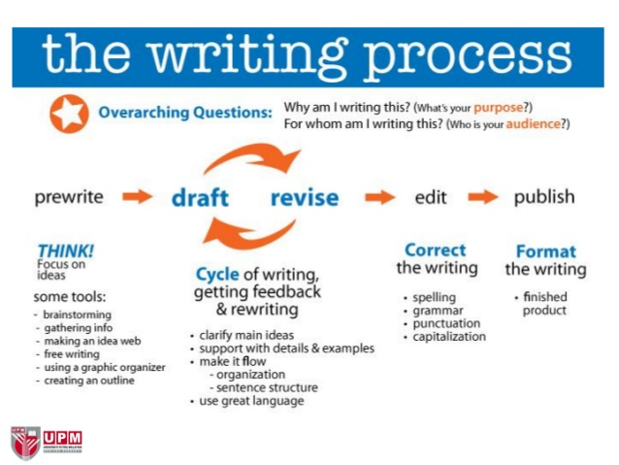
RECALL!

Slide 3
Technical Writing Process
“It’s a reconstruction of an investigation.”

Slide 4
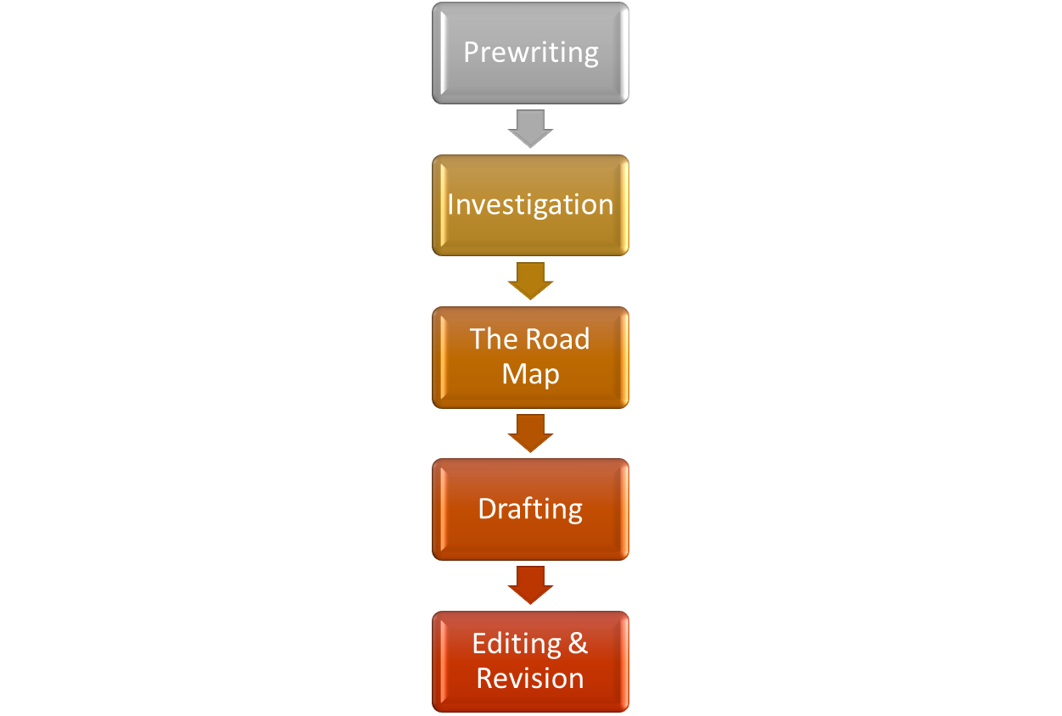
The Technical Writing Process-TWP

Slide 5
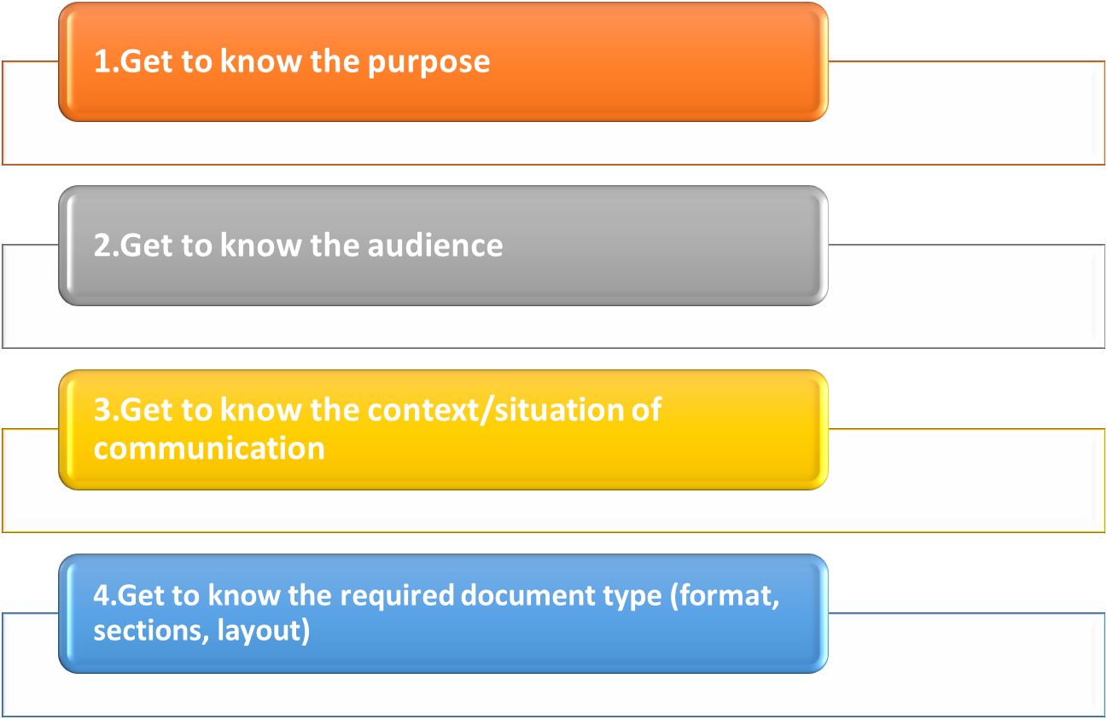
TWP- Pre-Writing

Slide 6
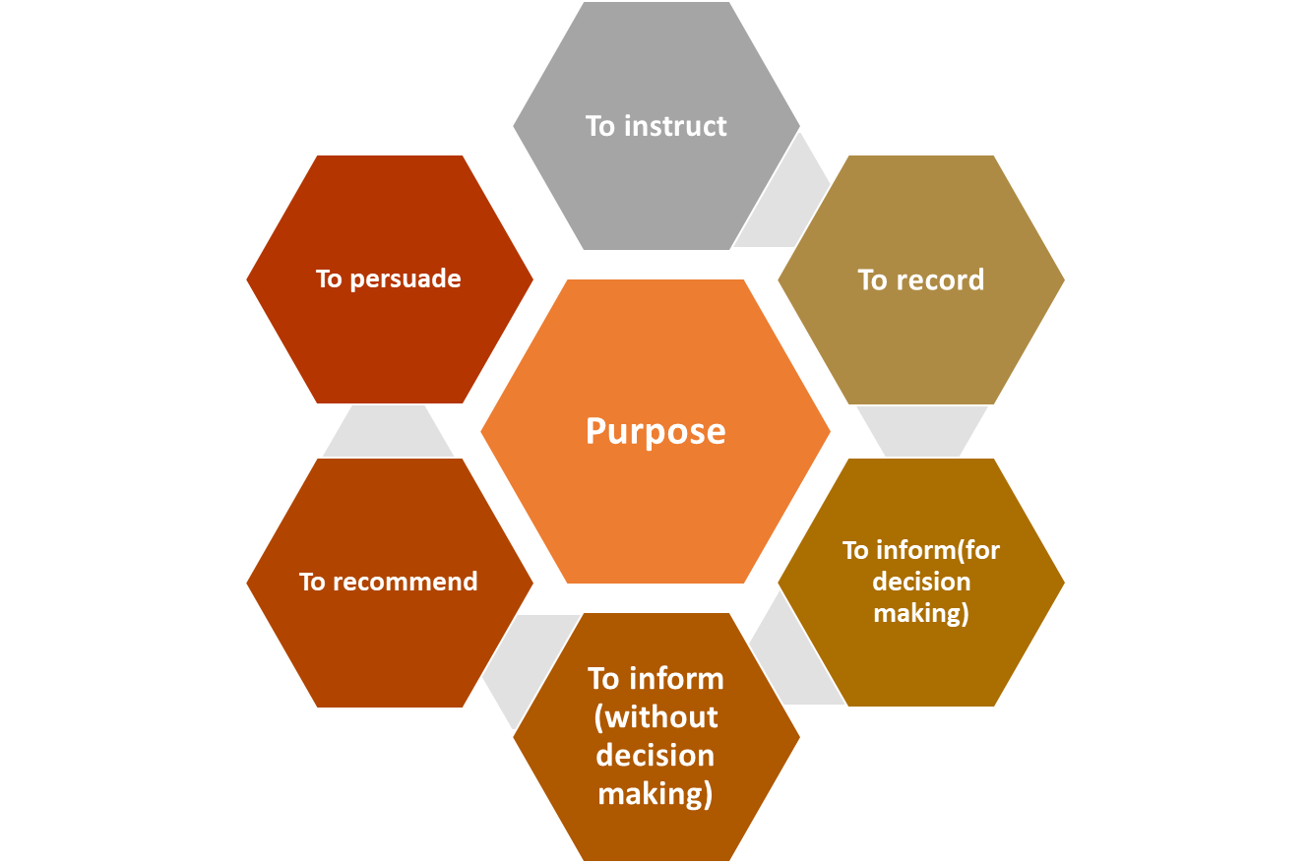
Analyzing the purpose

Slide 7
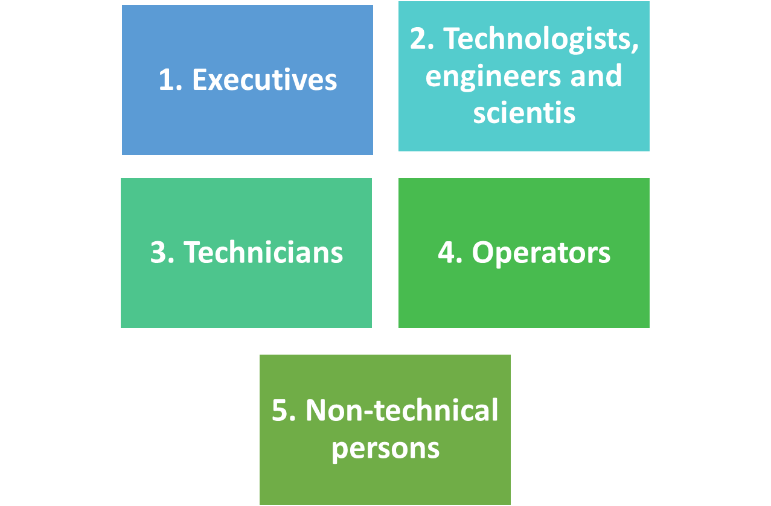
Analyzing Audience

Slide 8
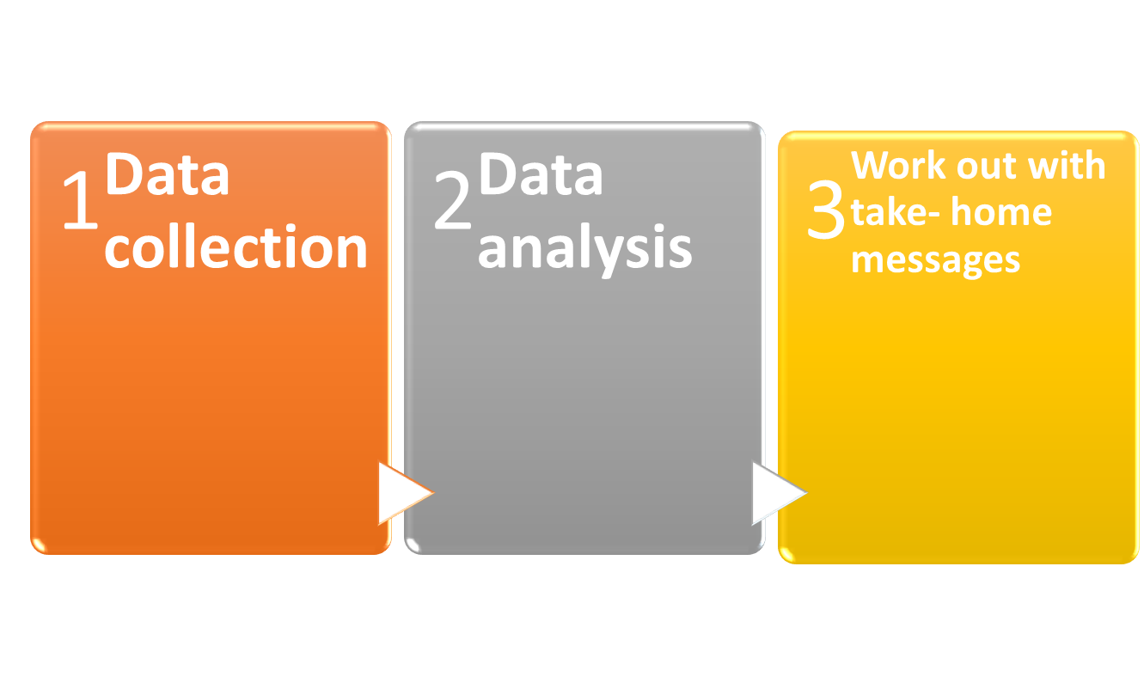
TWP- Investigation

Slide 9
TWR- Investigation
Some Advice
Get organized first.
  Don’t try to write and gather information simultaneously!
  Gather and organize information BEFORE
Develop an organizational system that suits you.
Spend more time organizing and less time writing.

Slide 10
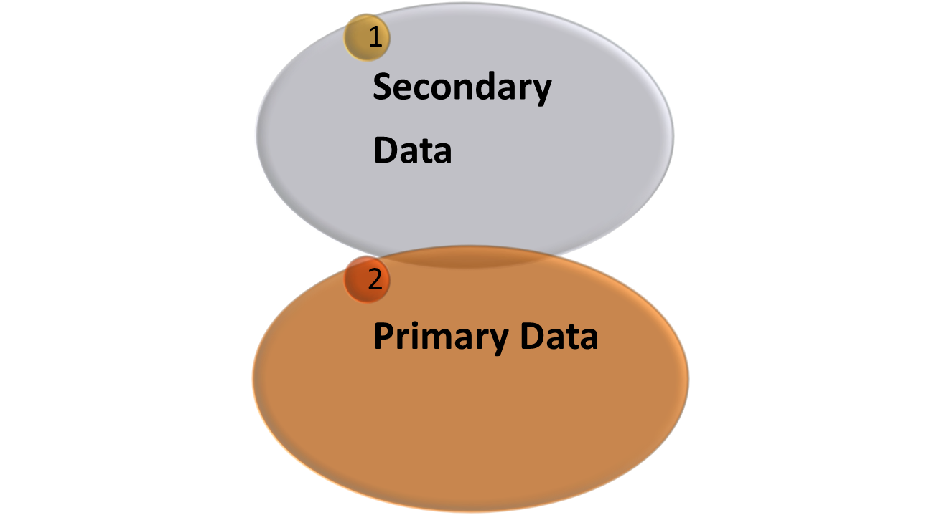
TWR- Investigation-Determine the type of data you need

Slide 11
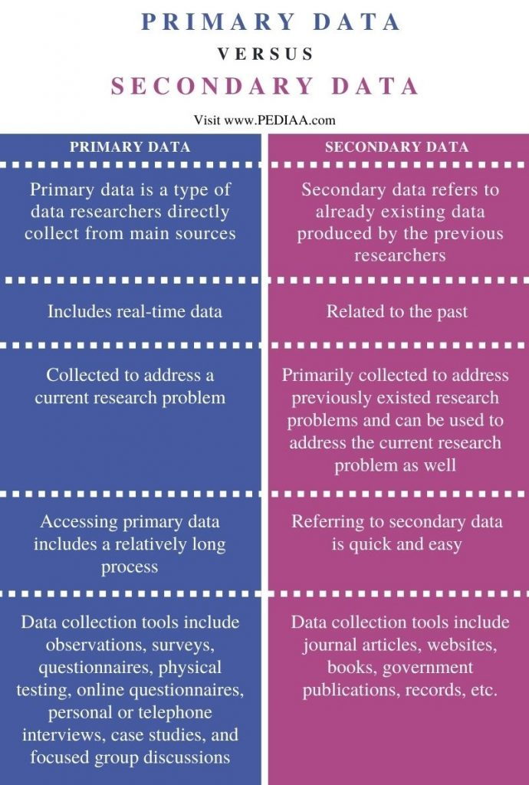

Slide 12
TWR- Investigation-Secondary Sources
Technical reports (industrial/corporate/available in company records)
Research papers/articles (academic)
Governmental reports and documents
Newspaper
Leading business/tech magazines
Recognized business/tech blogs/podcasts/wikis

Slide 13
TWR- Investigation-Secondary Sources
Technical books
Almanacs and statistical resources
Interviews on TV, radio, etc
Electronic databases
Online databases
Company websites

Slide 14
TWR- Investigation-Recognized Research Journal Publishers
IEEE
ACM
Sage
Emerald
Taylor and Francis
Wiley
Elsevier
Routledge
Springer

Slide 15
TWR- Investigation-NOTE
Document your sources.

Slide 16
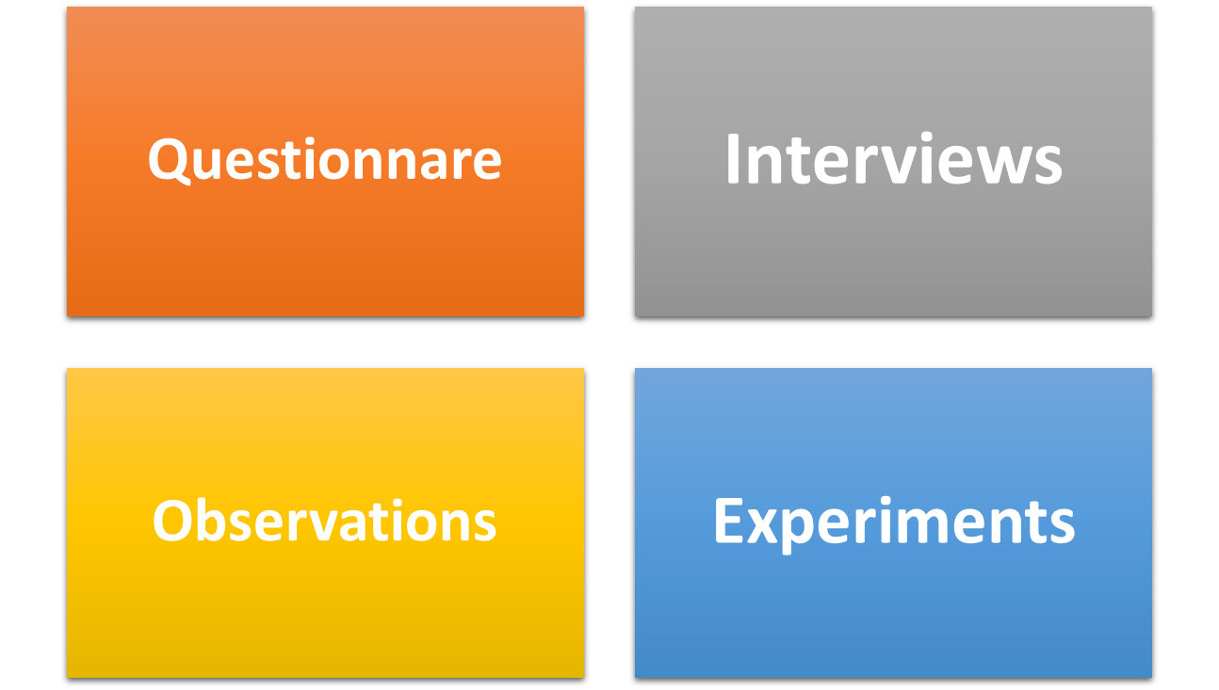
TWP- Investigation-Primary Data collection methods

Slide 17
TWP- Investigation-Sampling
For primary data, choose research participants carefully.
Your questionnaire must measure what it is intended to measure.
Define your target population.
Draw a representative sample out of it if it is too large.
There can be two sampling methods

Slide 18
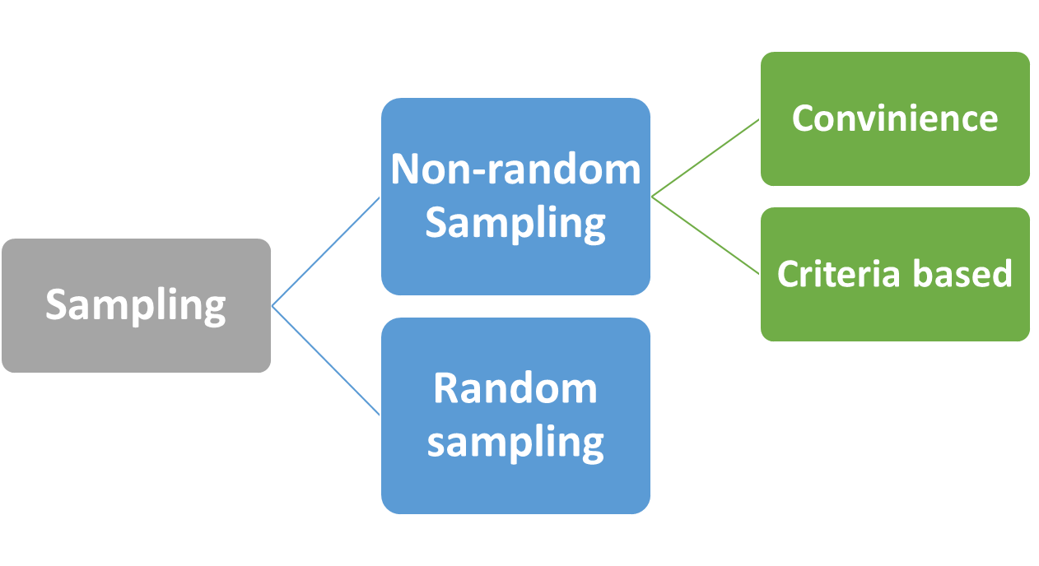
TWP- Investigation-Sampling methods

Slide 19
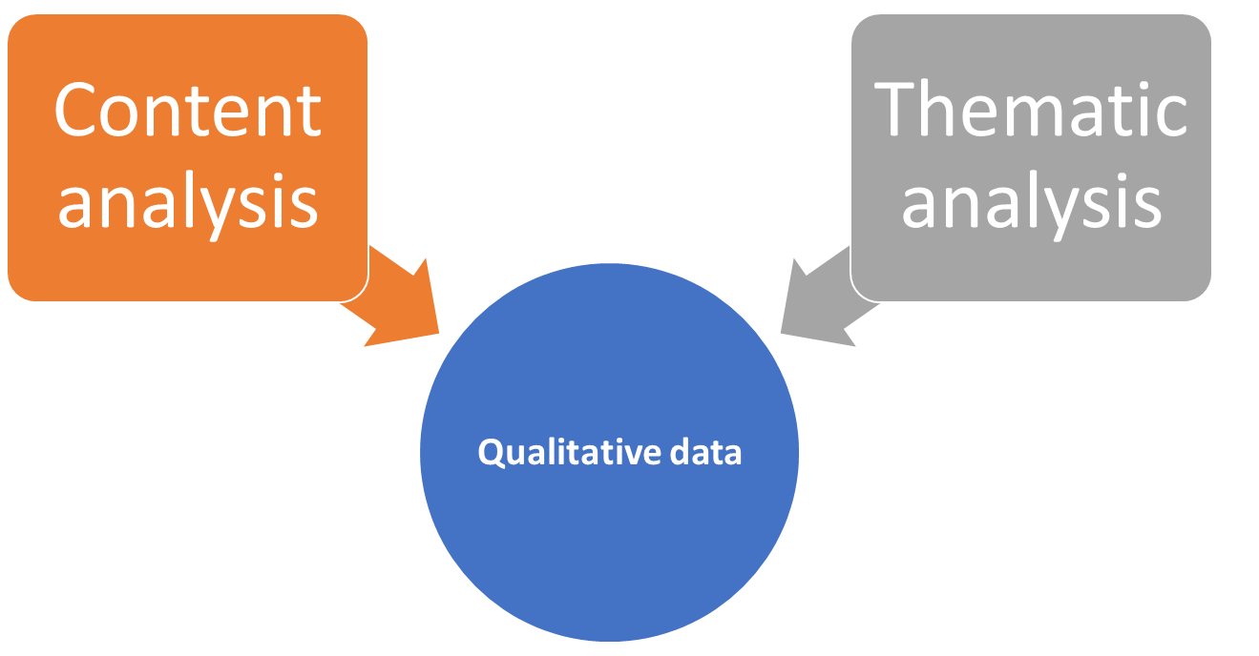
TWP- Investigation-Data analysis

Slide 20
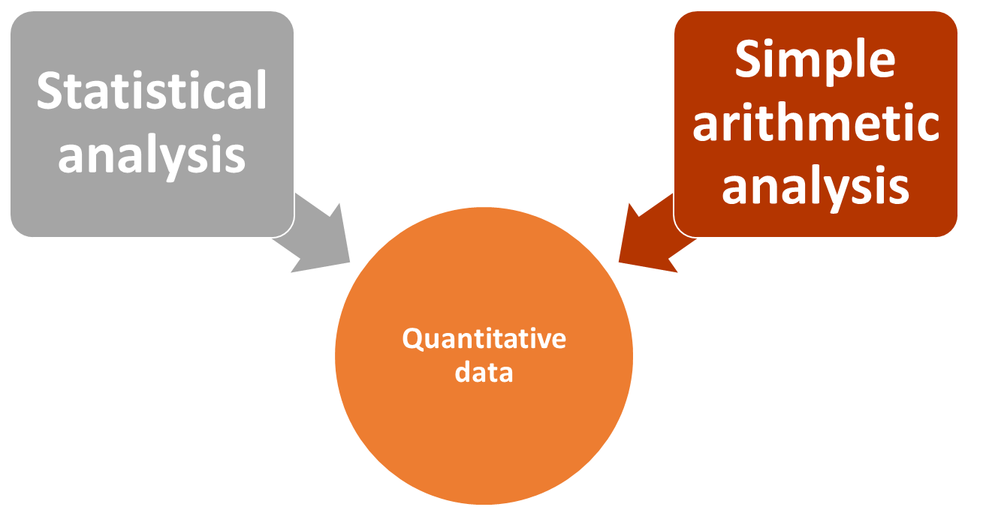
TWP- Investigation-Data analysis

Slide 21
TWP- Investigation-Data Analysis
Data have to be processed.
Analyze data and extract relevant information and find answers to the research questions.
Separate main ideas from supporting evidences and details.
Assign headings to related information.
Be objective and unbiased.

Slide 22
TWP- Investigation-Data Analysis-Secondary data
You can use information from secondary sources in three ways:
  Quote a source (use quotation marks/indented paragraphs for longer passages)
  Paraphrase the material and mention the source
  Summarize-present the gist of the material in your own words (give main ideas leaving out supporting information)

Slide 23
TWP- Investigation-Statistical analysis
Use statistical software
Simple arithmetic analysis can also be done, like, mean, median, mode, percentages, frequency
Analyze the data to spot trends-any repeatable patterns taking place over time, including growth, decline, and cyclic trends
Analyze causation (cause and effect relationship between 2 factors/variables)
Correlation (simultaneous change in 2 variables that you are measuring such as customer satisfaction drops when product reliability drops)

Slide 24
TWP- The Road Map
Arrange key facts and citations from the literature into a crude road map/outline BEFORE writing the first draft.
Think in paragraphs and sections…

Slide 25
TWP- The Road Map
Write on the go!
While exercising (Turn off that ipod!)
While driving alone (Turn off the radio!)
While waiting in line (Put down the magazine!)
Work out take-home messages
Organize your paper
Write memorable lines

Slide 26
TWP- The Road Map-Compositional Organization
Like ideas should be grouped.
Like paragraphs should be grouped.
Don’t “Bait-and-Switch” your reader too many times.
When discussing a controversy, follow:
arguments (all)
counter-arguments (all)
rebuttals (all)

Slide 27
TWP-Drafting
Don’t be a perfectionist!
The goal of the first draft is to get the ideas down in complete sentences in order.
Focus on logical organization more than sentence-level details.
Writing the first draft is the hardest step for most people. Minimize the pain by writing the first draft quickly and efficiently!

Slide 28
TWP-Revision & Editing
Read your writing out loud
  The brain processes the spoken word differently than the written word!
Edit for Style (SCOPE)
Do an organizational review
  In the margins of your paper, tag each paragraph with a phrase or sentence that sums up the main point.
  Then move paragraphs around to improve logical flow and bring similar ideas together.

Slide 29
TWP-Revision & Editing
Get outside feedback
  Ask someone outside your department to read your manuscript.
  Without any technical background, they should easily grasp:
    the main findings
    take-home messages
    significance of your work
  Ask them to point out particularly hard-to-read sentences and paragraphs!

